Slide 1
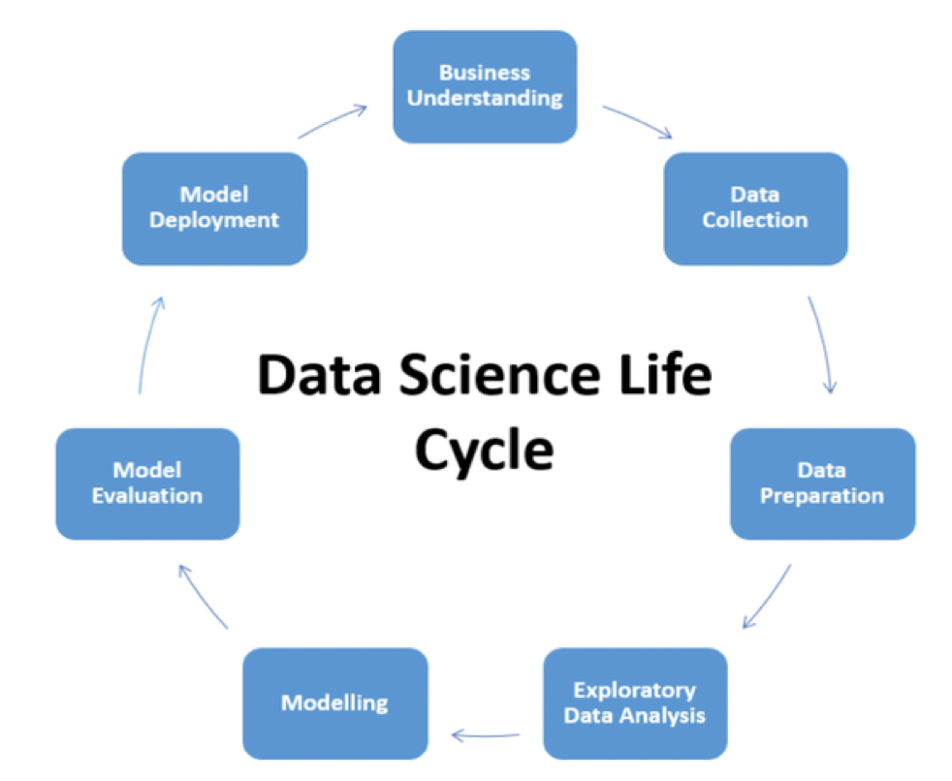
PROJECT OVERVIEW:-
To protect the insurance providers from great loss due to this bad practice.
To protect the healthcare system so that they can provide quality and safe care to legitimate patients.
To reduce the cost of healthcare services.

Slide 2
Data Understanding :-
Understand the problem and collect the data.
Import the libraries, Read the dataset.
Find the shape and Data type, missing values, Check for the Null & nan values and Fill or remove null & nan values.
Handing duplicate values Remove unnecessary columns.
Find the pattern, outlier, and insights Use plots according to the data.
Percentage of genuine and fraud
How many fraud cases occurred
Find the Area services according to the result
Find the age distribution.
Data preprocessing and Machine Learning.

Slide 3

MACHINE LEARNING:-
Modeling
Data splitting
Model building
Logistic regression
Building Decision Tree Classifier
Random Forest Model

Slide 4
DATA FACT :-
Here the data consist of many features such as ,
Area_Service, Hospital County, Hospital Id Age, Gender, Cultural_group, ethnicity, Days_spend_hsptl , Admission_type , Home or self care, ccs_diagnosis_code, ccs_procedure_code , apr_drg_description, Code_illness, Mortality risk , Surg_Description , Weight_baby , Abortion, Emergency dept_yes /No, Tot_charg, Tot_cost, ratio_of_total_costs_to_total_charges , Result, Payment_Typology etc.
We used only important columns for our model building.
Here we perform EDA, Machine Learning algorithms, and no. of fraud, genuine cases, etc.

Slide 5
Model Accuracy:-
Sr.No | Classifier/Model | Train Accuracy | Test Accuracy
1. | Logistic Regression | 0.880873 | 0.88072
2 | Decision Tree | 0.97628 | 0.973316
3 | Random Forest | 0.9780555 | 0.975150
We finalize the Random forest Classifier because the accuracy of this model accuracy is greater than other models.

Slide 6
DEPLOYMENT:-
For deployment used streamlit
CONCLUSION:-
Check if the claim is Fraud or Genuine.

Slide 7
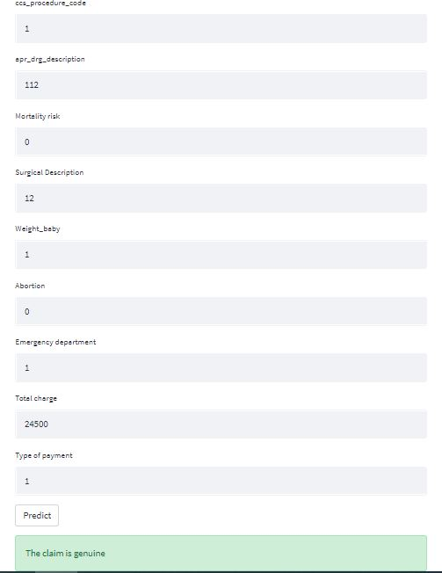
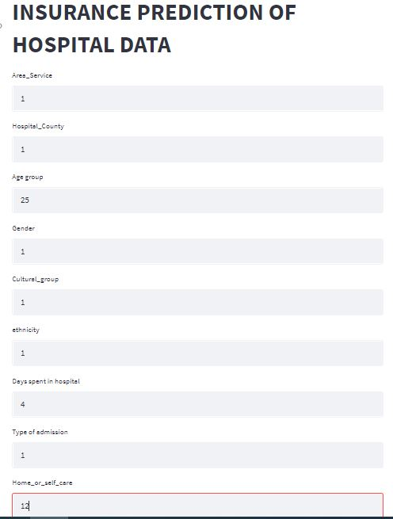
Output:-

Slide 8
THANK YOU

